Slide 1
HEALTH INSURANCE CROSS-SELL PREDICTION
PREDICTING WHICH HEALTH INSURANCE CUSTOMERS WILL BE INTERESTED IN BUYING AUTO INSURANCE

Slide 2

What is vehicle insurance?
Vehicle insurance is a contract between two parties, the insurance company and the insured customer, that protects the insured against financial loss in the event of an accident or theft, as listed in the policy, in exchange for a premium being paid by the customer.

Slide 3

Why get a vehicle insurance?

Slide 4
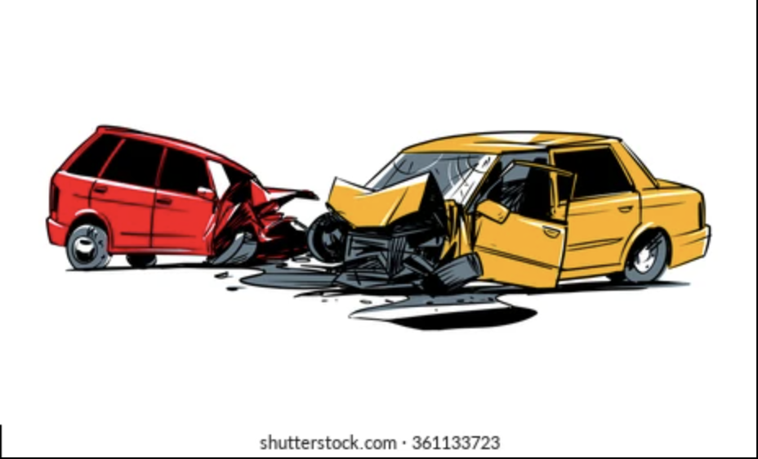
Collision of vehicles

Slide 5
Collision of vehicles

Slide 6
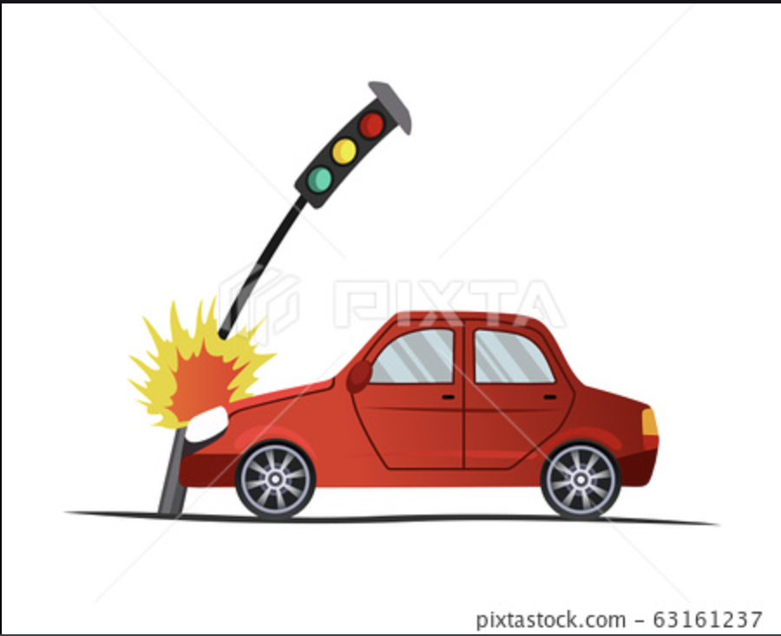
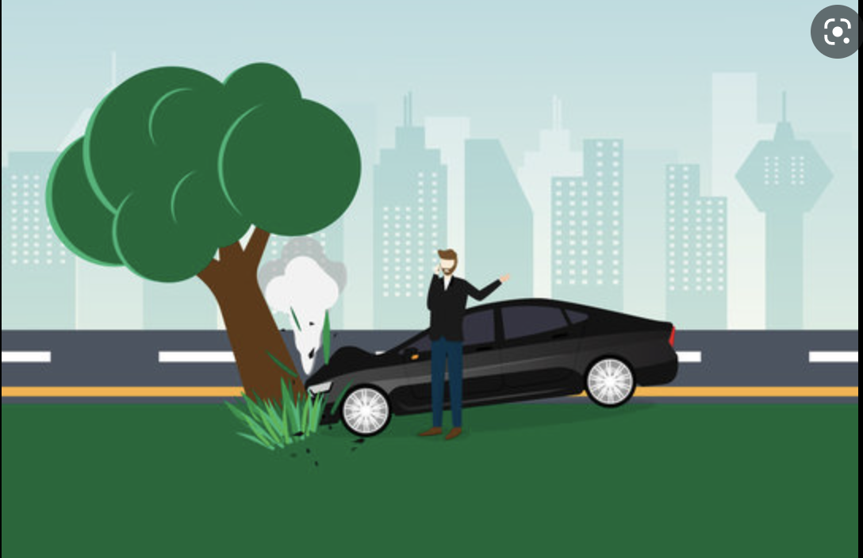
Collision with stationary objects

Slide 7
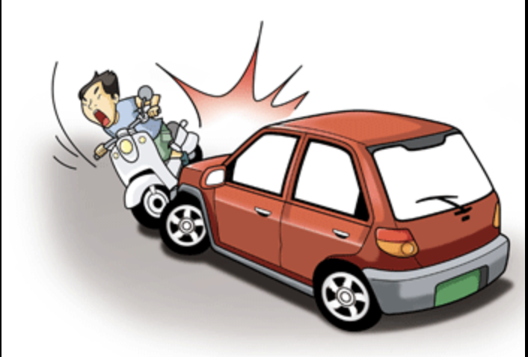
Collision with other road users

Slide 8

Pedestrians getting hit

Slide 9
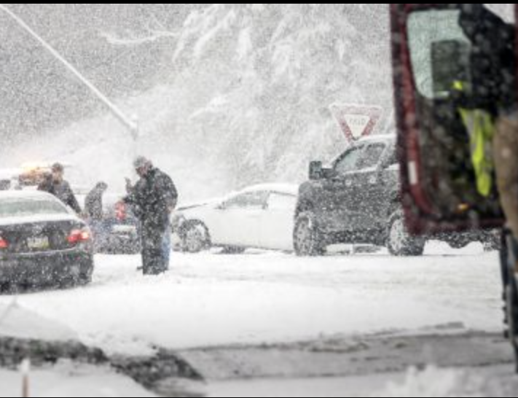
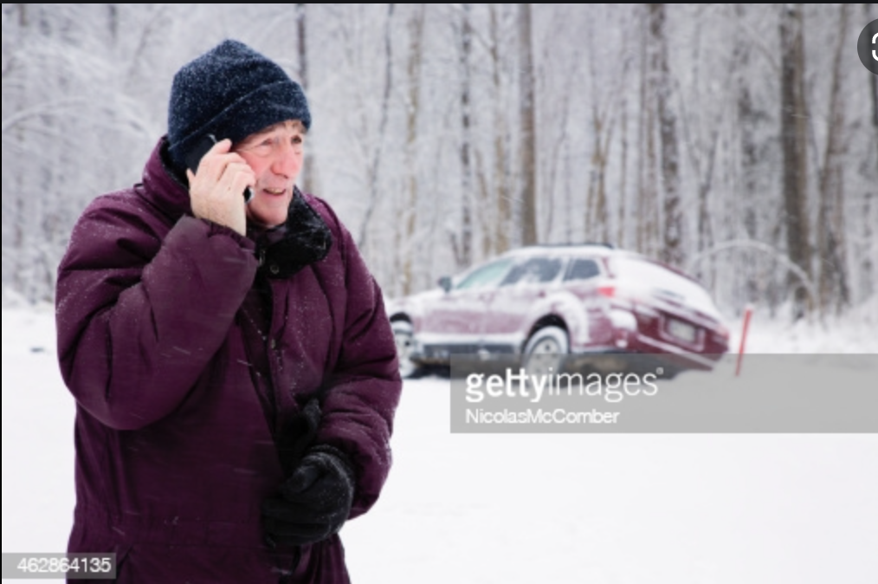
Accidents caused by bad weather

Slide 10

Vehicle theft

Slide 11
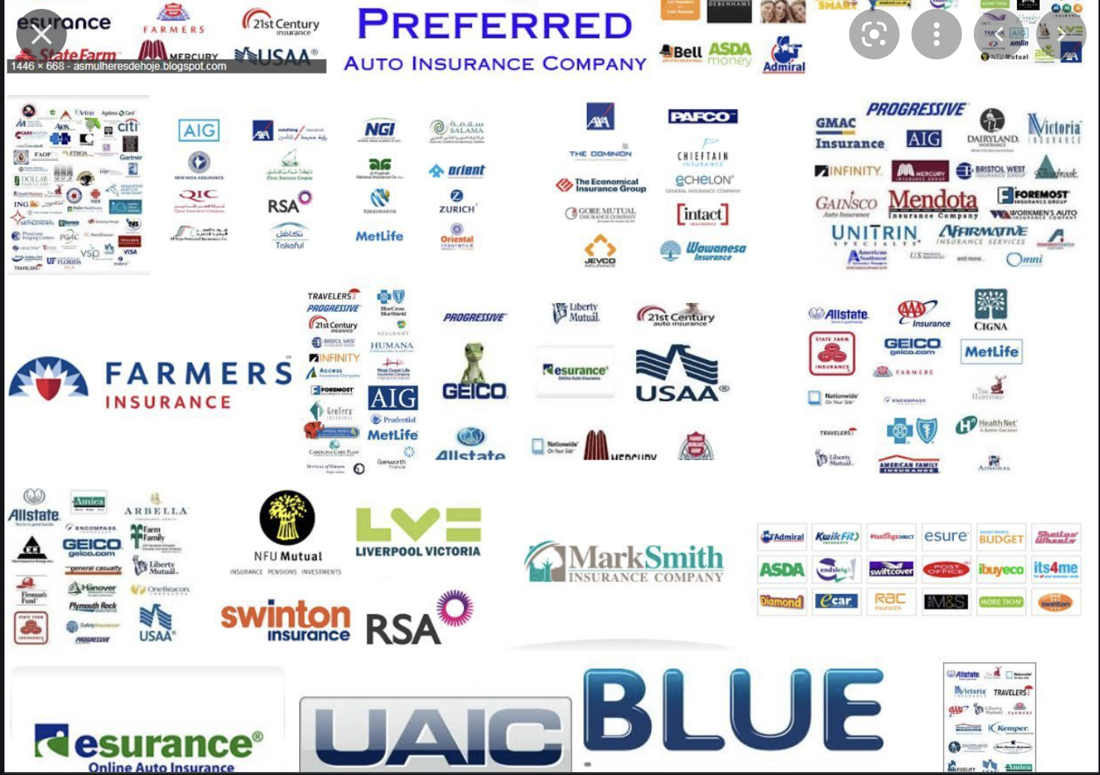
Modes of purchase
Many insurance companies provide different types of insurance and customers may get all their insurance coverages from one company or different coverages from different companies. It is important for these companies to understand and be able to identify which of their customers would be willing to get a different kind of insurance with them and how they can get the customers to do so.

Slide 12

Problem Statement
Which health insurance customers from the past year are likely to be interested in vehicle insurance?

Slide 13


Audience
The project is intended to help management and decision-makers at insurance companies identify potential auto insurance customers from their pool of already existing medical insurance customers.

Slide 14

EXPLORATORY DATA ANALYSIS

Slide 15
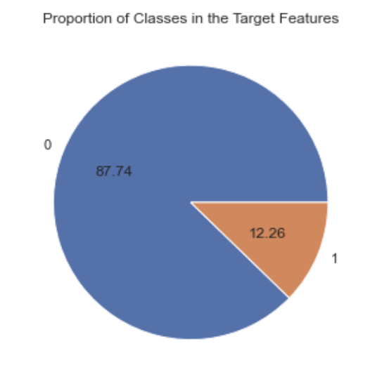
Data Imbalance
Very high data target class imbalance

Slide 16
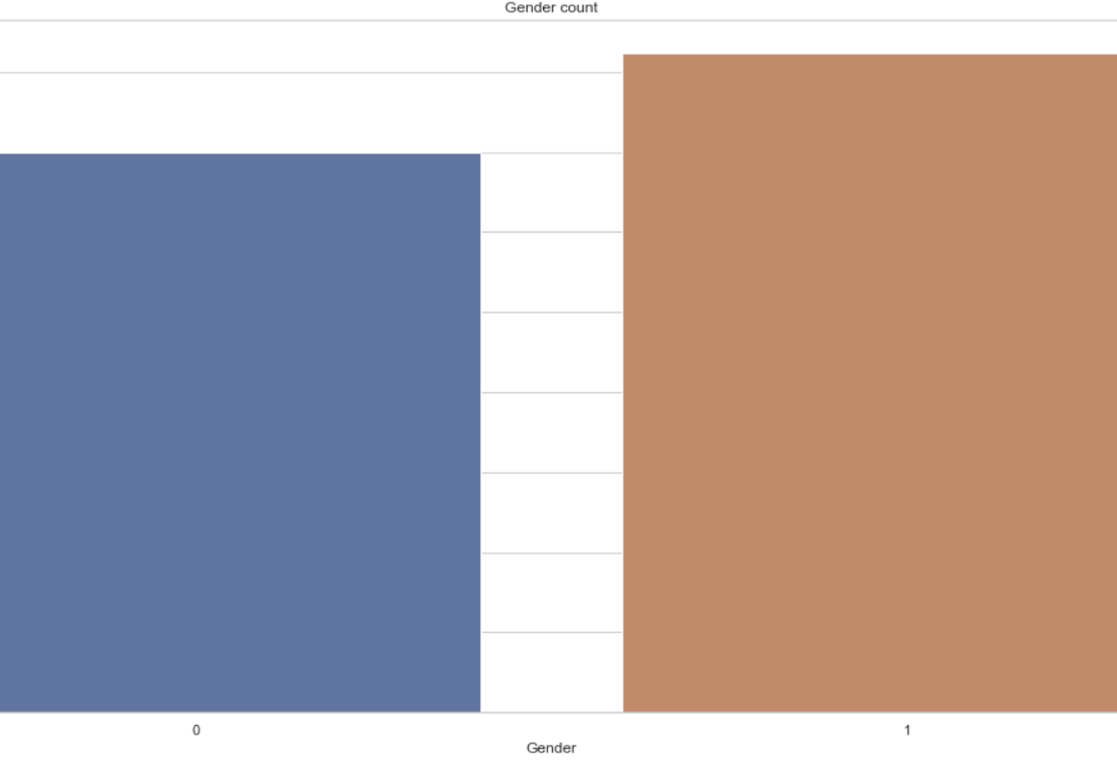
Gender
Males = 54% Females = ~46%

Slide 17
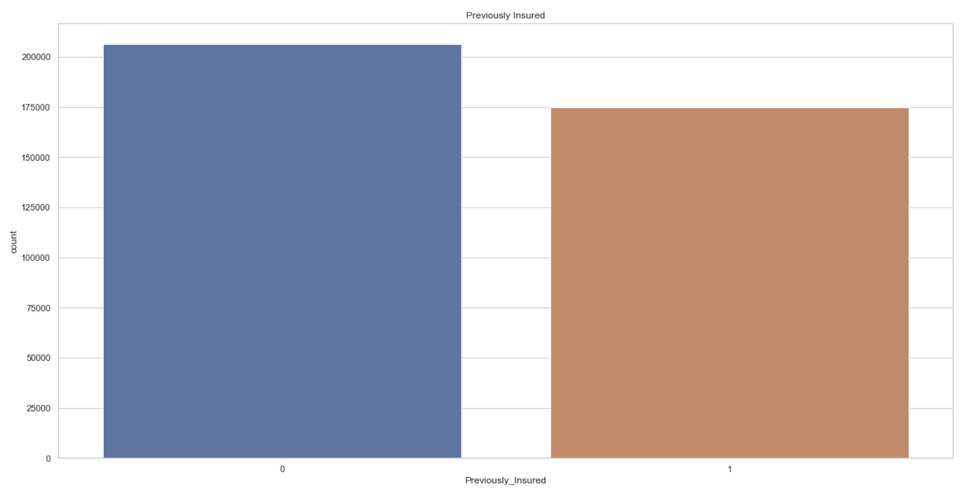
Previously Insured
Insured = 54% Uninsured = ~46%

Slide 18
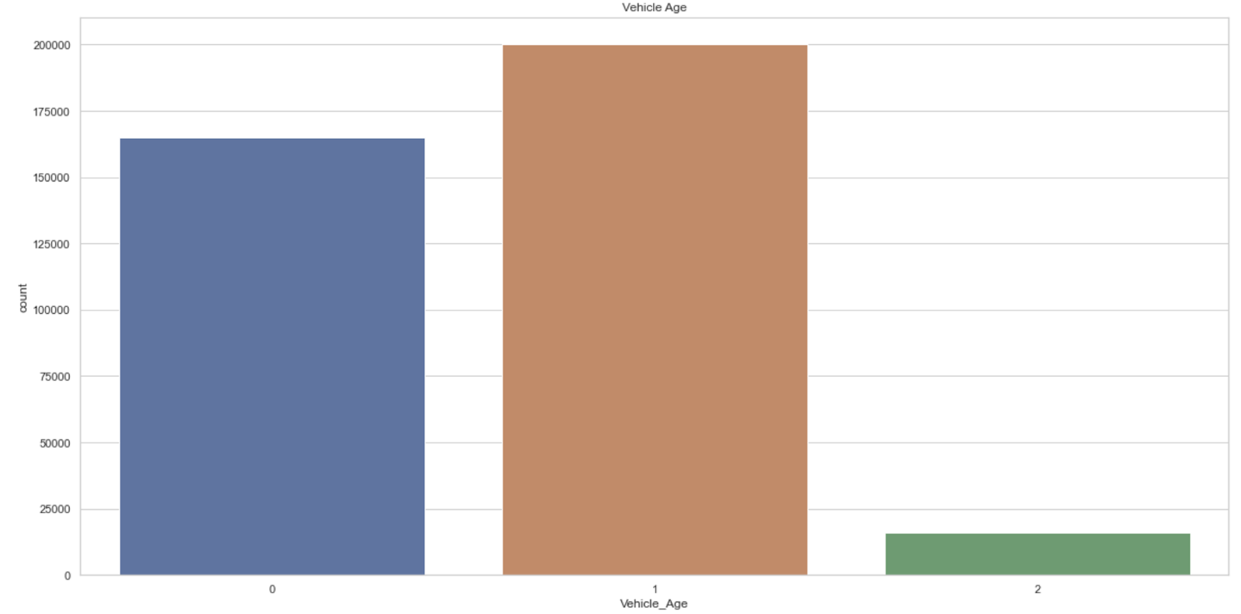
Vehicle Age
1-2 years = 52.5% < 1 year = 43% > 2 years = 4%

Slide 19
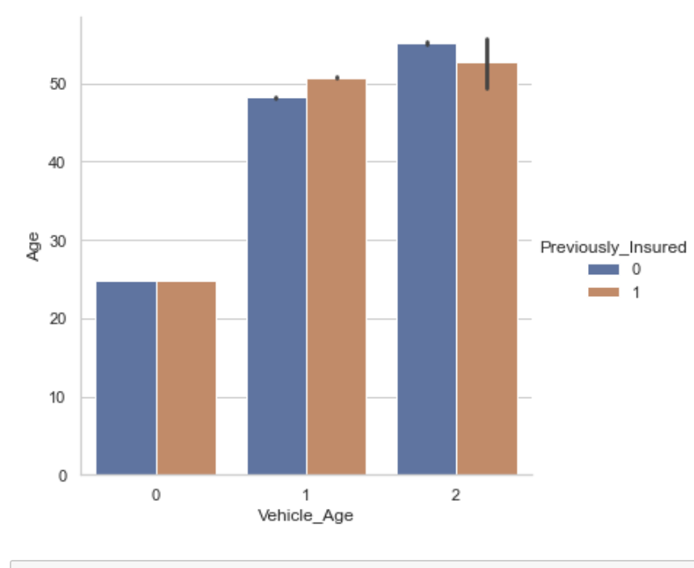
Previously Insured Based on Vehicle Age
< 1 year = same
1-2 years = slightly more insured than not insured
> 2 years = slightly more not insured than insured

Slide 20
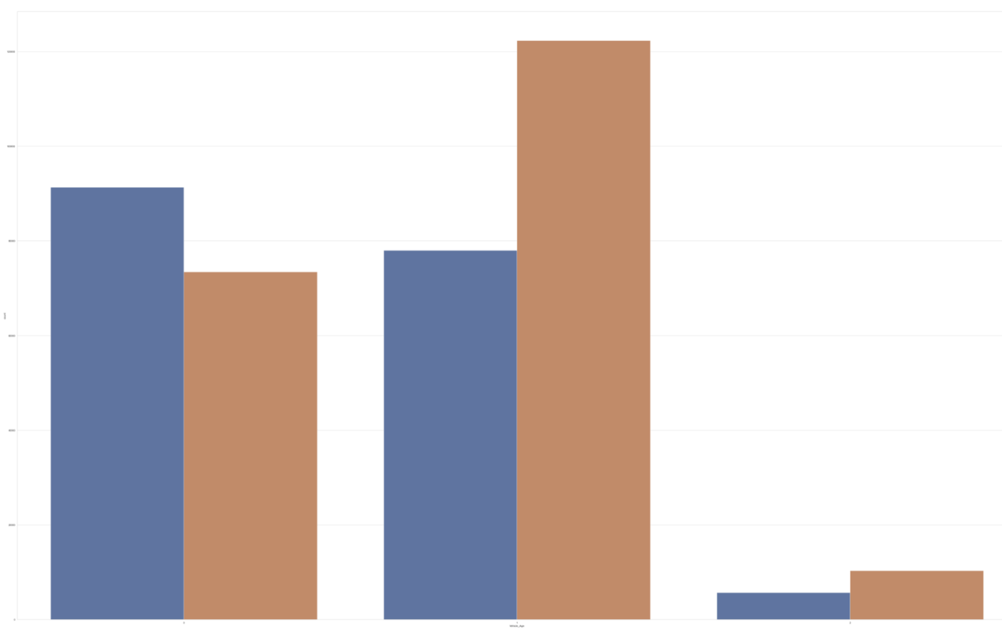
Gender Based on Vehicle Age or Vice Versa
< 1 year = more females than males
1-2 years = more males than females
> 2 years = more males than females

Slide 21
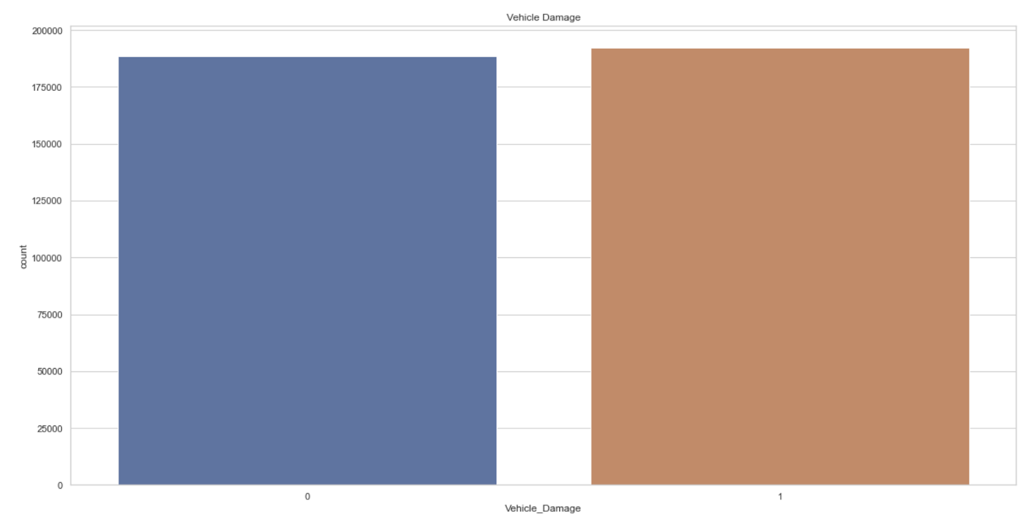
Vehicle-Damage By Customers
Damaged = 50.5%
Not Damaged = 49.5%

Slide 22
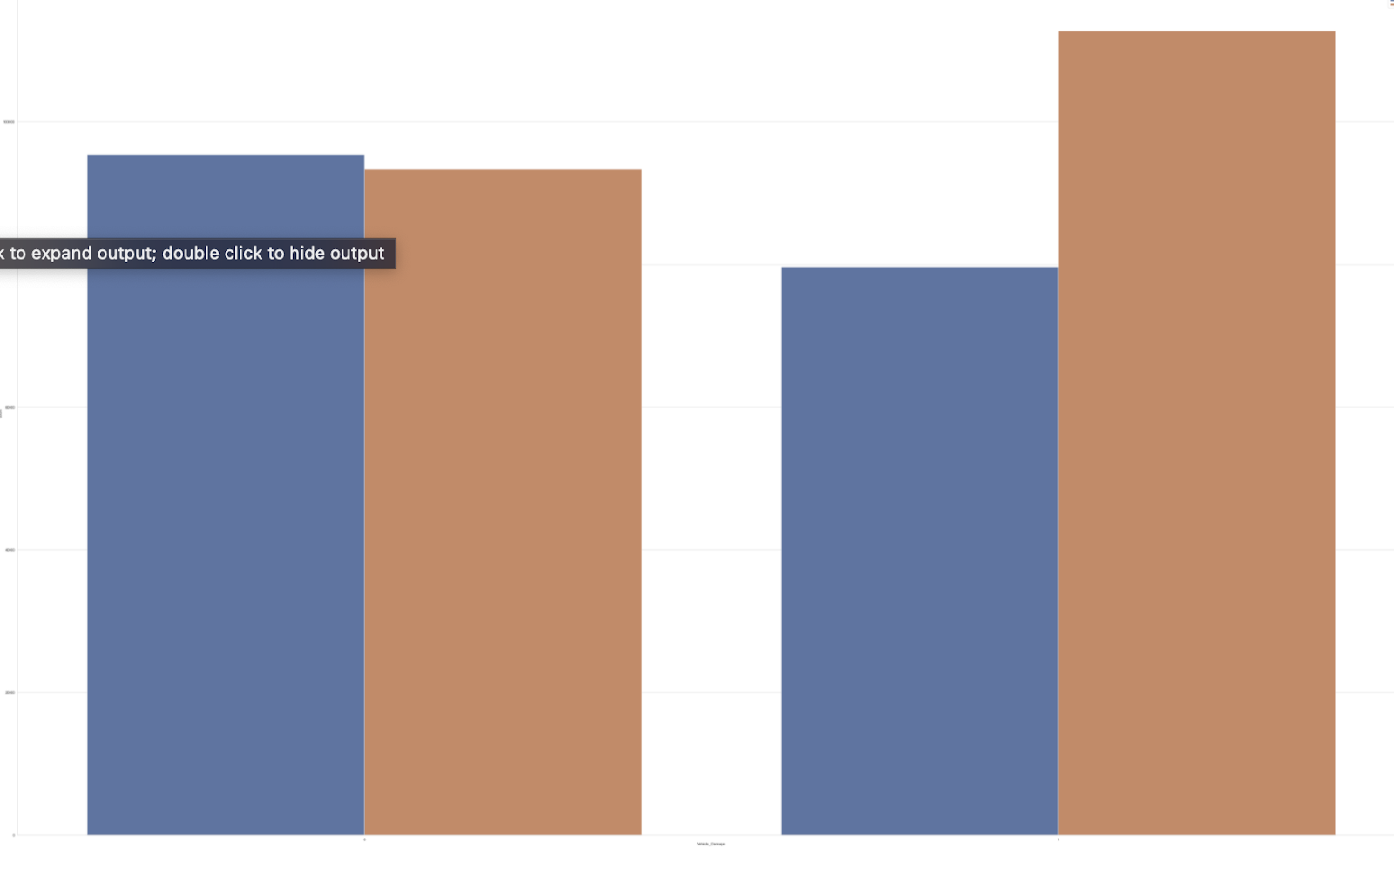
Vehicle-Damage Based on Gender
Not Damaged = More females
Damaged = More males

Slide 23
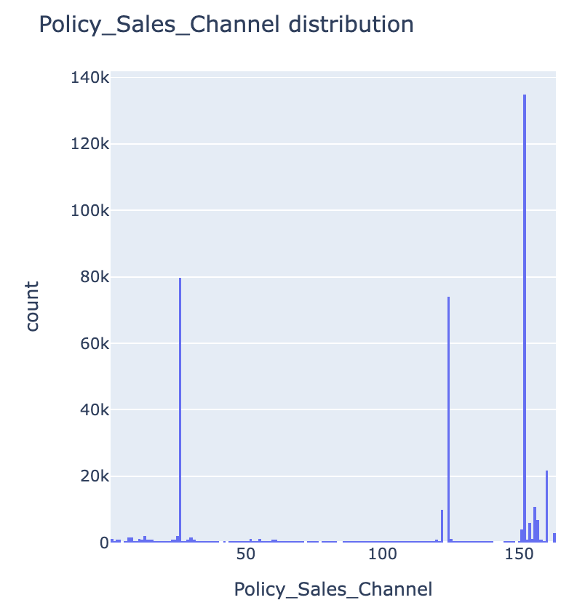
Sales Channel
Highest = 152
Second highest = 26
Third highest = 124

Slide 24
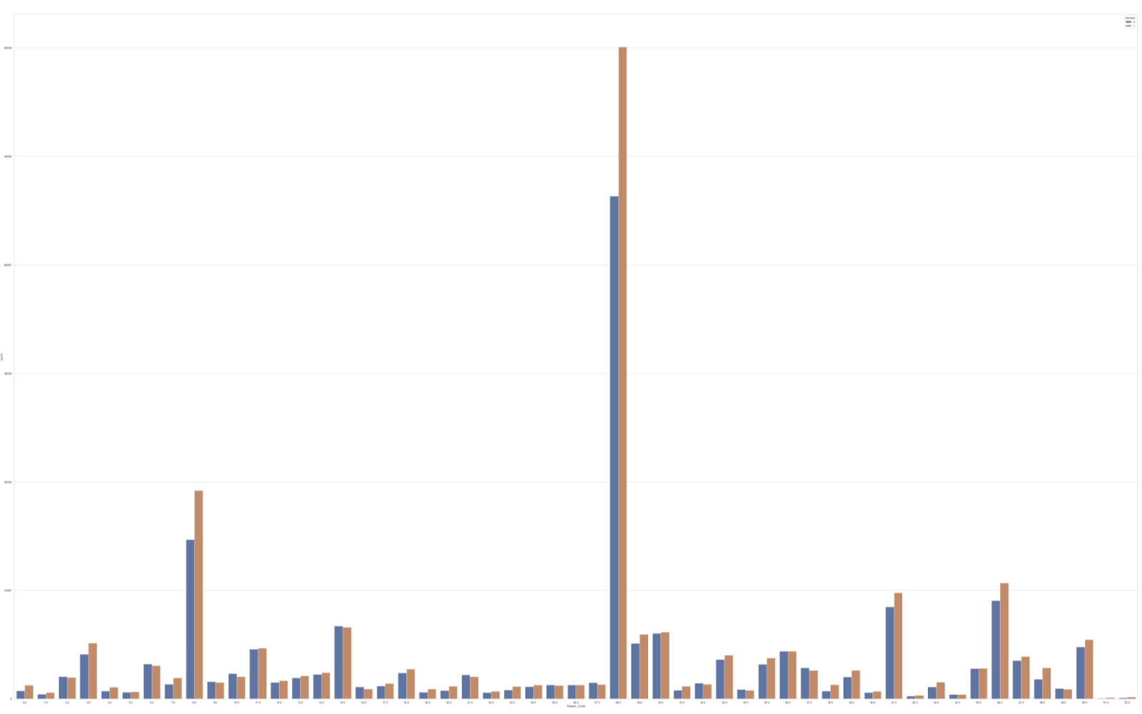
Gender Based on Region
More males in almost all the regions
Highest customers = 28
Second highest = 8

Slide 25
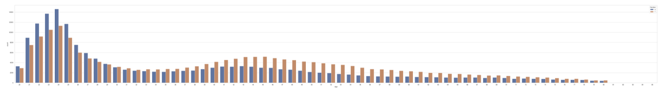
Vehicle Ownership By Gender
More females own vehicles at a younger age than males
More older men own vehicles than older women

Slide 26

MODELING

Slide 27
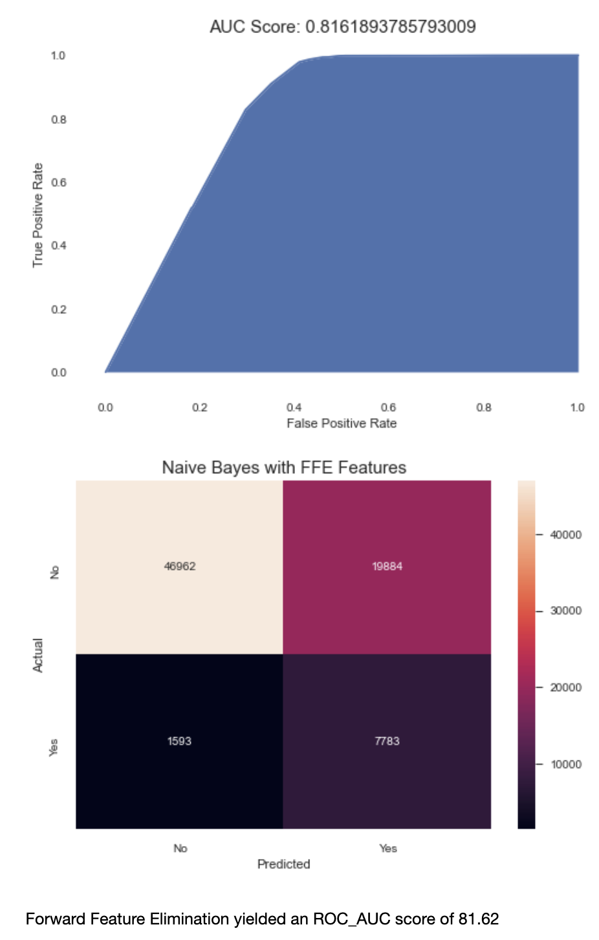
Bayesian (Bernoulli)
With an F1 score of ~0.7 and 0.42 on train and test data respectively and an ROC_AUC score of ~82, Bayesian (Bernoulli) model with Forward Feature Elimination’s suggested features scored higher than Recursive Feature Elimination which had an F1 score of

Slide 28
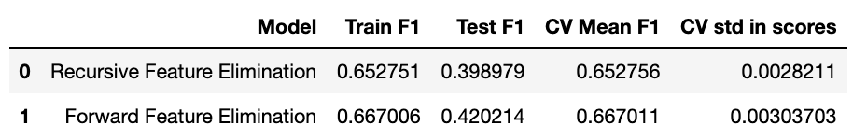
How they compare

Slide 29
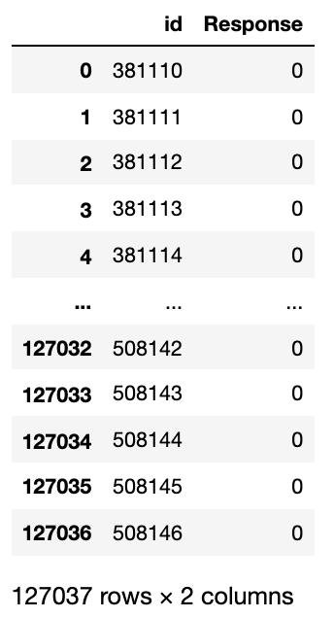
Sample prediction by Bayesian (Bernoulli) model with FFE features

Slide 30

Recommendation So, based on the findings of this project, my recommendations are that male customers who have driver's licenses, who are between mid-thirties and mid-fifties, who have had their vehicles damaged at some point, who do not currently have their vehicles insured, whose vehicles are aged between one and two years, and got their insurance through channels 152, 26 and 124 especially those from regions 28 and 8, are our likely potential auto insurance customers.

Slide 31
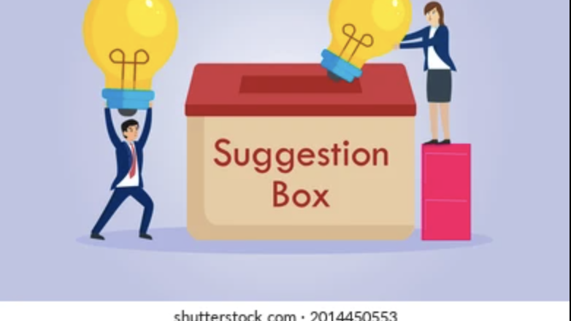
Suggestion For Improvement
More data of health and auto insurance customers should be added to the data to avoid high data imbalance. This will greatly improve the model and help get better results during testing. Also, the level of contribution of customer age to vehicle damage could be checked. That is, what age groups have damaged the most and least vehicles. Some other sophisticated or high-level classification models should also be used on the data to see if they will make better predictions.

Slide 32

Thank You For Your Time!

Slide 33
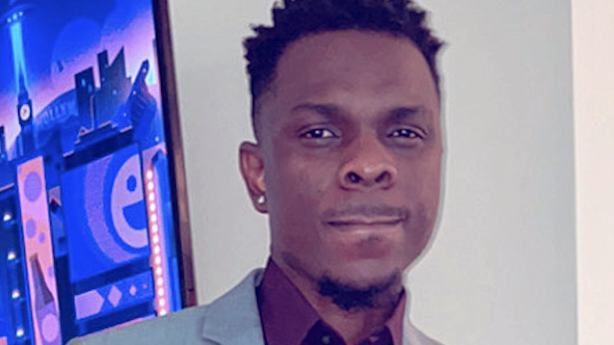
dambrielf667@yahoo.com https://github.com/dambrielf67 https://www.linkedin.com/in/damilola-efuwape-876988120/

